Slide 1
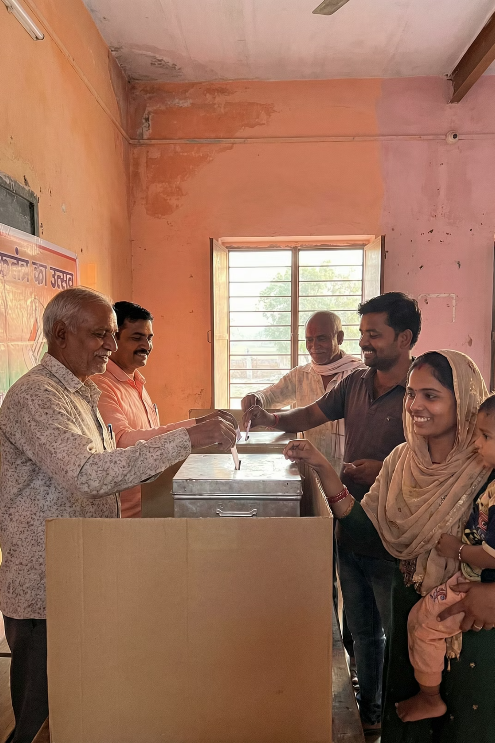

Indian Election Analysis
Team B
GUDA ANURAG PRATEEK
ABHINAV BHUTRA
NALLA DEEPIKA

Slide 2

ABSTRACT
Making Election Data Accessible Through Visualization
Elections form the cornerstone of democracy in India, empowering citizens to select their representatives. Yet raw election data remains dense and challenging to interpret for most stakeholders.
This project harnesses Power BI's analytical capabilities to transform complex electoral datasets into clear, actionable insights. Through interactive dashboards and strategic visualizations, we illuminate patterns in party performance, vote distribution, gender participation, and constituency-level trends.
Our approach bridges the gap between data complexity and public understanding, serving both everyday citizens and political strategists with accessible election intelligence.

Slide 3



Understanding India's Democratic Framework
Parliamentary Elections
Assembly Elections
Voter Behavior Analysis
National-level elections determine Members of Parliament who shape federal policy and governance across India's diverse landscape.
State-level contests select Members of the Legislative Assembly, governing regional affairs and implementing localized policies.
Understanding electoral outcomes requires deep analysis of political trends, shifting preferences, and evolving party dominance patterns.
India's parliamentary democracy operates through a dual-tier electoral system. This project employs advanced data analysis techniques to decode the intricate dynamics shaping both national and state-level political landscapes.

Slide 4
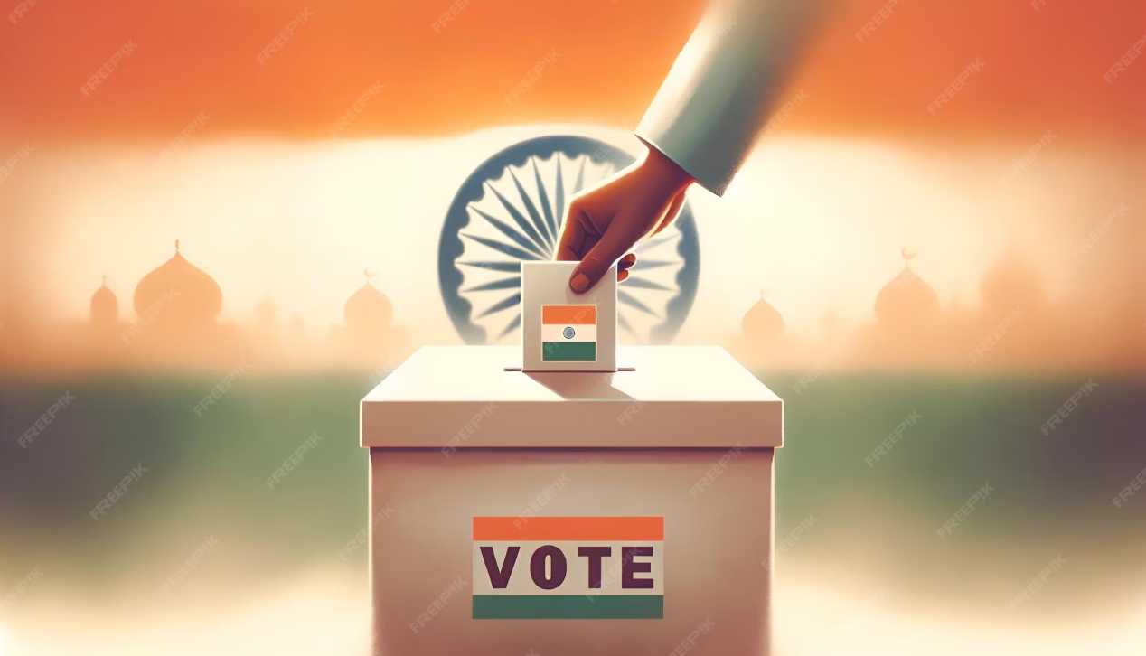
PROJECT SCOPE
Transforming Complex Data Into Clear Insights
This analytical initiative focuses on Indian Parliamentary and Assembly elections, leveraging Power BI to convert sprawling datasets into interactive, user-friendly dashboards.
Our comprehensive examination reveals critical patterns across multiple dimensions: voting behaviors, party performance trajectories, candidate success metrics, and gender participation trends spanning different states and election cycles.
Through sophisticated visualization techniques, we empower stakeholders—from political analysts to engaged citizens—to grasp election outcomes with unprecedented clarity and make data-informed interpretations.

Slide 5








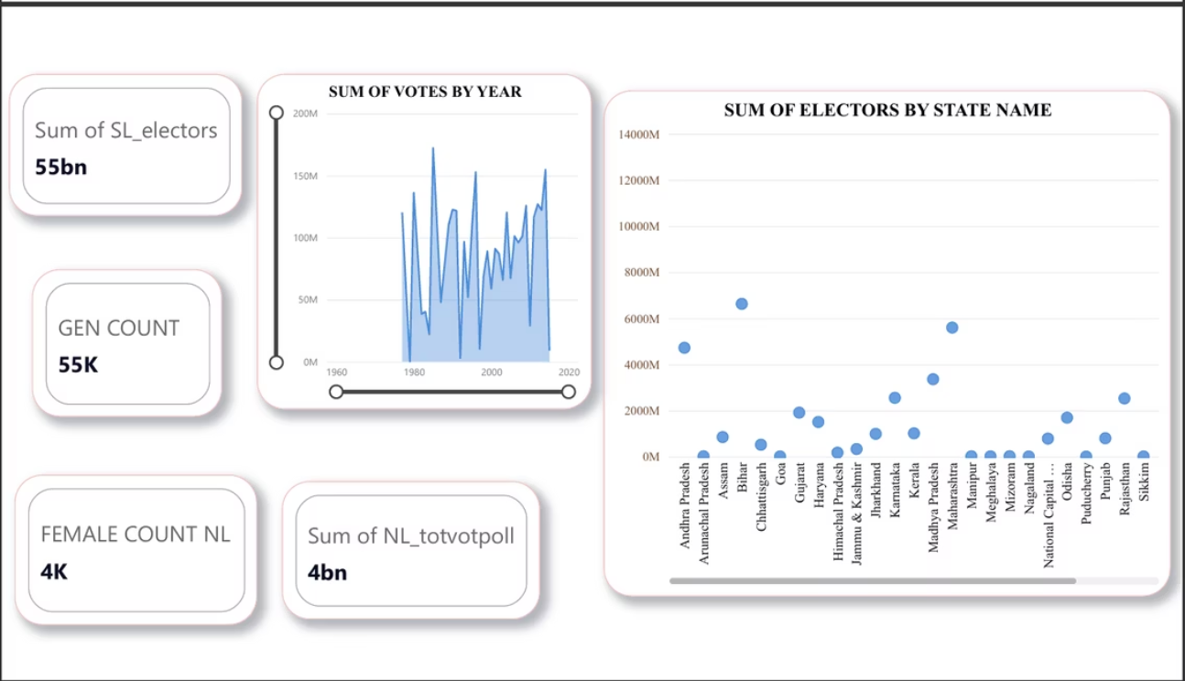

Data Foundation & Technical Architecture
Data Collection
Power BI Platform
Sourced from open-source Kaggle repository containing comprehensive candidate information, party affiliations, constituency details, vote counts, and registered elector statistics across multiple election years.
Primary analytical engine enabling sophisticated data modeling, interactive visualizations, and dynamic dashboard creation for stakeholder engagement.
Power Query
DAX Calculations
Handles data preparation, cleansing operations, and structural transformations to ensure dataset integrity and analysis readiness.
Creates calculated measures and columns, enabling complex aggregations and custom metrics that drive deeper analytical insights.

Slide 6
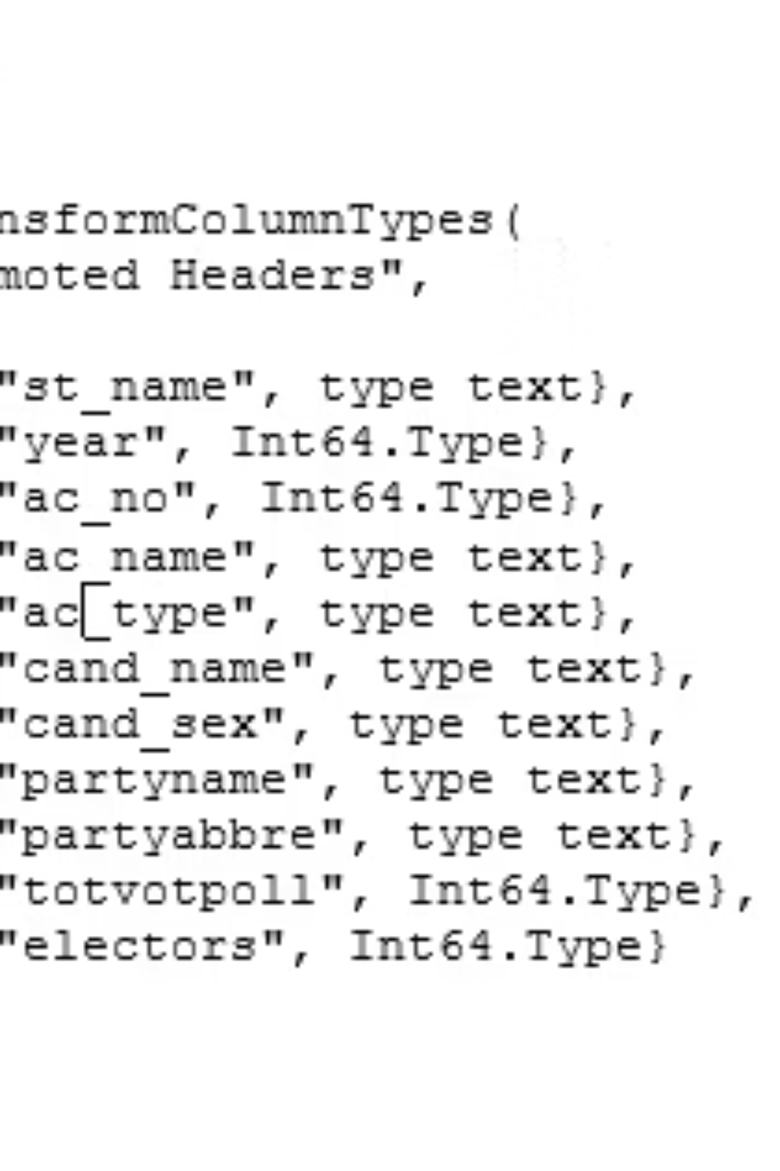
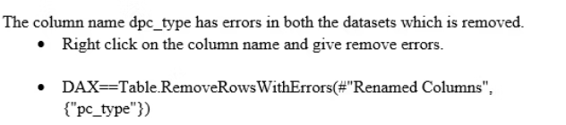
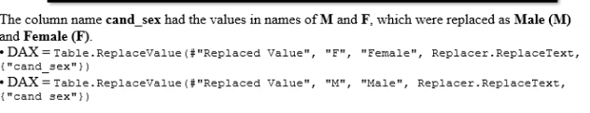
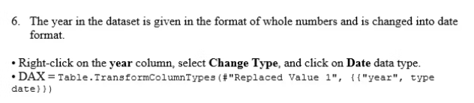
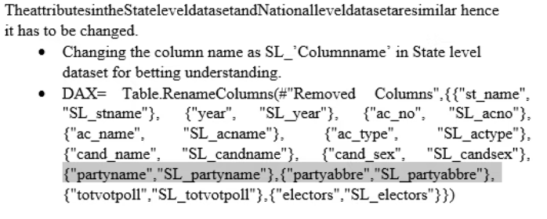
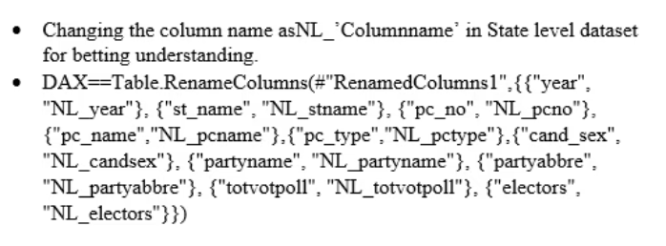
TECHNICAL SPECIFICATIONS
DAX Formulas Powering Our Analysis
Custom calculations and measures form the analytical backbone of our election intelligence platform. These DAX formulas enable sophisticated metrics and dynamic aggregations.
Vote Aggregations
Performance Metrics
Trend Calculations

Slide 7




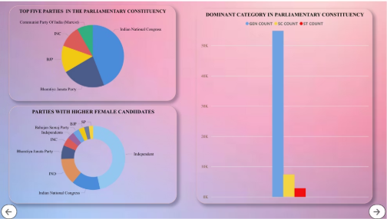
Data Preparation & Architecture Design
Data Cleaning
Removed inconsistencies, standardized gender values, refined column names, and eliminated invalid entries to ensure analytical accuracy and reliability.
Power Query Transformation
Filtered, renamed, and restructured datasets using Power Query's ETL capabilities to prepare data for optimal analytical performance.
Star Schema Modeling
Designed efficient relationships between fact and dimension tables, enhancing query performance and enabling sophisticated reporting capabilities.
Rigorous data preparation forms the foundation of meaningful analysis. Our systematic approach to cleaning and modeling ensures every insight derived from the platform rests on accurate, well-structured information.

Slide 8

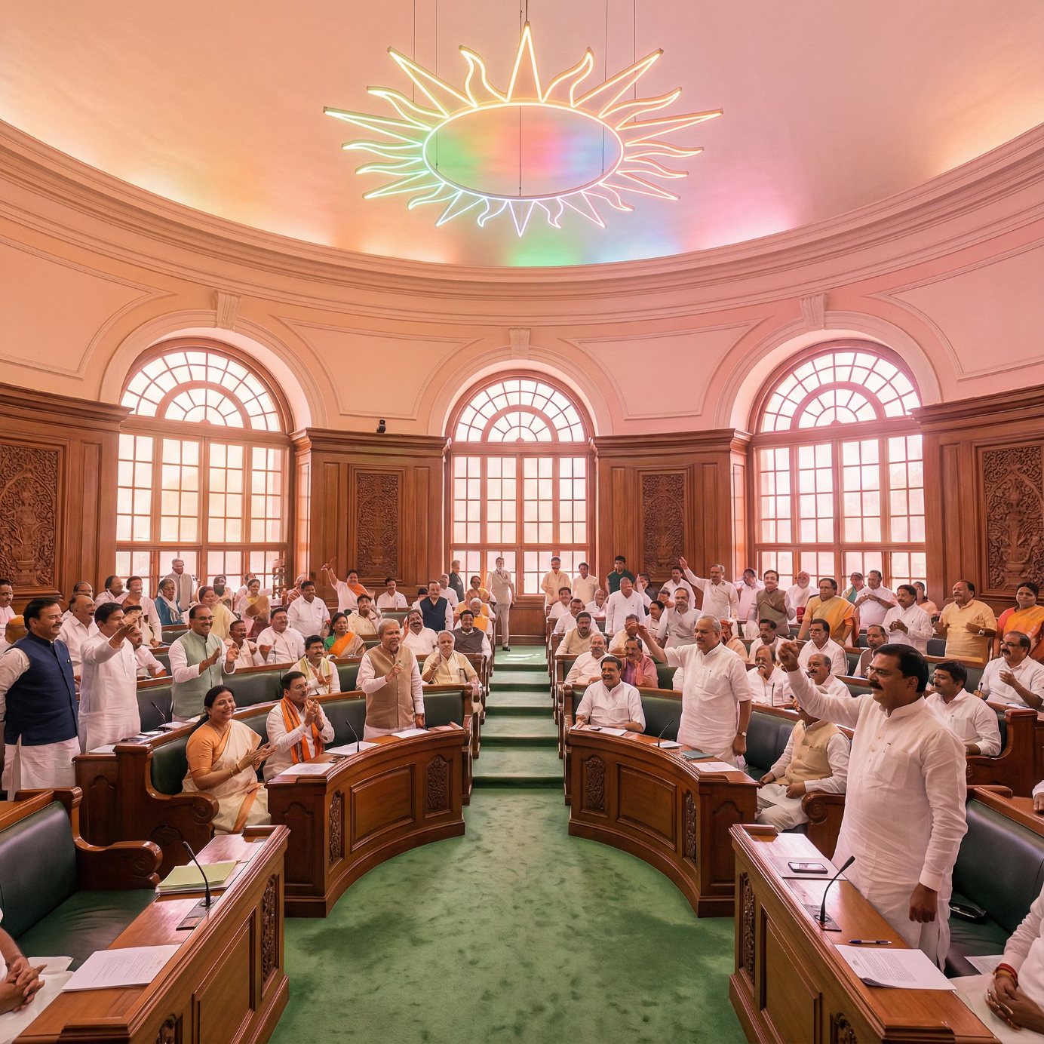




NATIONAL LEVEL
Parliamentary Constituency Analysis
Our Parliamentary analysis examines national election dynamics, revealing which political parties dominate India's federal landscape and how their influence has evolved over successive election cycles.
The investigation identifies leading constituencies, evaluates reservation category representation, and highlights the growing role of female candidates in shaping national political discourse.
Dominant Parties
Tracking which political organizations consistently secure parliamentary seats and command voter loyalty across diverse regions.
Reservation Trends
Analyzing representation across scheduled castes, scheduled tribes, and general categories in parliamentary constituencies.
Leading Cities
Identifying urban centers wielding significant electoral influence.
Female Participation
Measuring women's growing presence and success rates in India's national electoral arena.

Slide 9

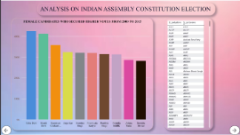
STATE LEVEL
Assembly Constituency Analysis
State-level elections reveal distinct regional political dynamics that differ significantly from national patterns. Our Assembly analysis uncovers top-performing candidates, major vote-securing states, and gender-based participation trends.
Special focus on Tamil Nadu highlights candidates who have demonstrated consistent electoral success across multiple years, offering insights into sustained regional political strategies.
Top Candidates
Leading States
Identifying individual politicians who repeatedly secure strong mandates in state assembly contests through effective grassroots engagement.
States commanding the largest voter bases and exhibiting unique political preferences that shape regional governance.
Gender Distribution
Tamil Nadu Focus
Tracking male and female candidate participation rates and success patterns across different state assemblies.
Deep-dive analysis of candidates maintaining electoral dominance in this politically significant southern state over multiple election cycles.

Slide 10


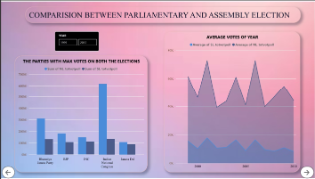

Comparative Election Analysis
PARLIAMENTARY VS ASSEMBLY
A side-by-side comparison of Parliamentary and Assembly elections reveals fascinating differences in voter behavior, party strategies, and electoral outcomes between national and state-level contests.
1
Party Dominance Patterns
National parties perform differently at federal versus state levels, with regional parties often commanding stronger Assembly influence.
2
Average Votes Analysis
Year-over-year voting trends demonstrate divergent participation patterns between Parliamentary and Assembly elections.
3
Total Vote Comparison
Aggregate vote counts reveal how voter turnout and engagement vary significantly based on election type and perceived stakes.
Key Insight: Understanding these comparative dynamics helps political strategists tailor campaigns effectively for different electoral contexts while enabling analysts to predict future trends with greater accuracy.

Slide 11
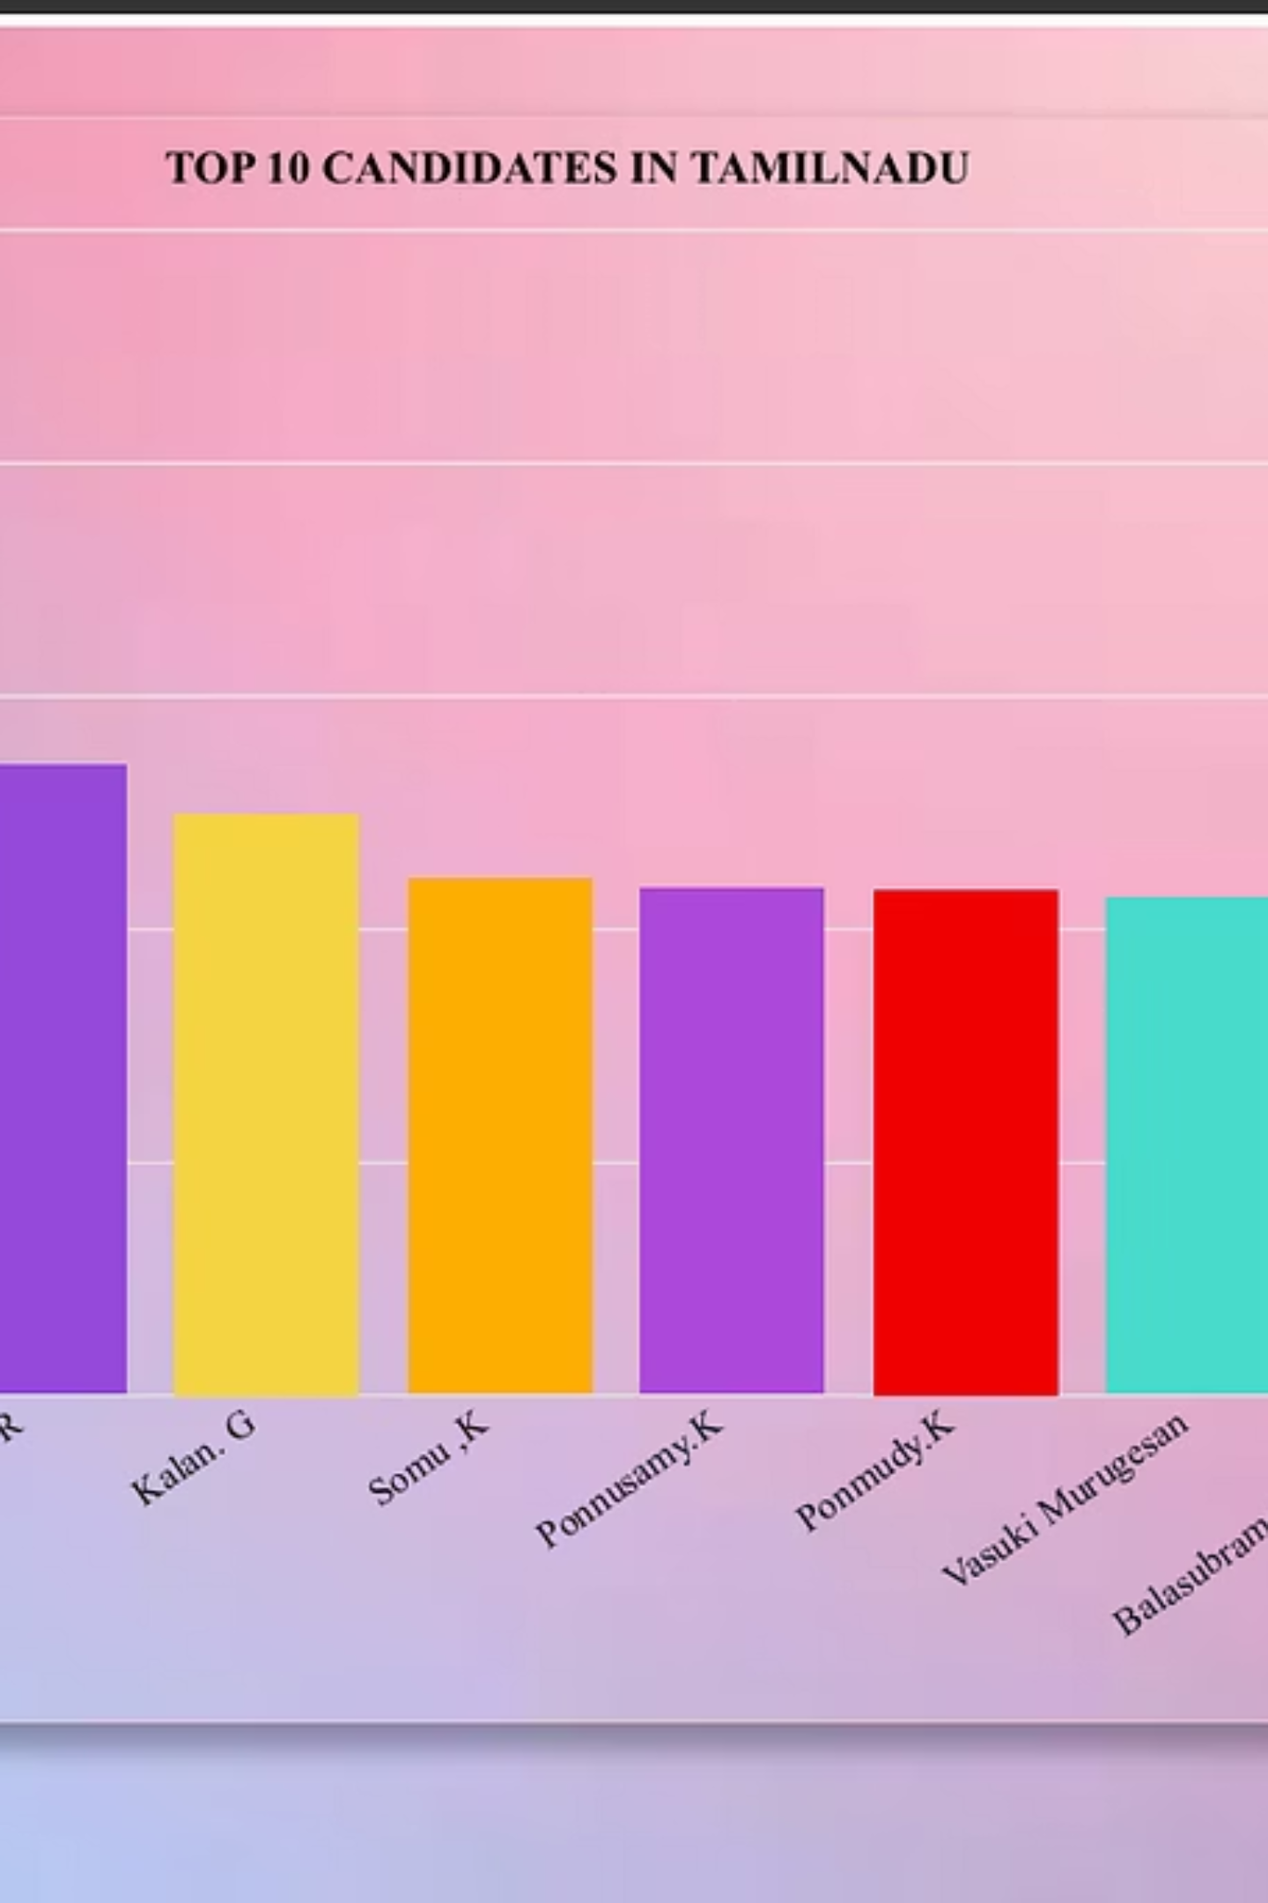






Conclusion
This project successfully demonstrates how Power BI transforms Indian election data into actionable insights through interactive dashboards. By analyzing party performance, voting trends, gender participation, and constituency-wise results, the visualization platform enables political parties, candidates, and citizens to understand complex election outcomes with remarkable clarity.
Interactive Analysis
Voter Insights
Dynamic dashboards reveal patterns across multiple electoral dimensions
Gender participation and demographic trends made transparent
Data-Driven Decisions
Converting raw datasets into strategic electoral intelligence
Overall, this analysis proves that sophisticated data visualization plays a vital role in democratizing access to large-scale election information, making democratic processes more transparent and understandable for all stakeholders.

Slide 12

Thank You
Team B
Guda Anurag Prateek
Abhinav Bhutra
Nalla Deepika

